Slide 1
Node JS
https://www.youtube.com/playlist?list=PL1BztTYDF-QPdTvgsjf8HOwO4ZVl_LhxS

Slide 2
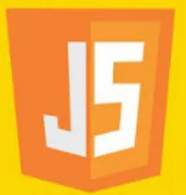

What is Node JS?
Node.js is a JavaScript runtime
built on Google's open source V8 engine

Slide 3
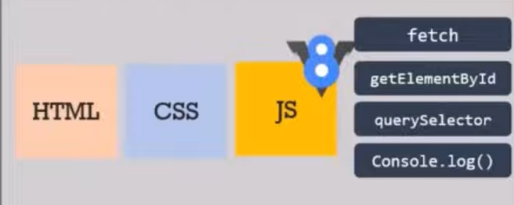
History
Before 2009 JavaScript was only capable of running inside a browser there was no way to run a JavaScript program outside of the browser environment and in every browser, there is a JavaScript engine which is responsible for executing the JavaScript code.
JavaScript engine is a tool which is required by browsers to execute and run JavaScript code every browser has their own JavaScript engine for example
Firefox uses spider monkey
Microsoft Edge uses chakra
Google Chrome uses V8 engine
So, this V8 engine is the one which is responsible for executing the JavaScript program in the Chrome browser

Slide 4
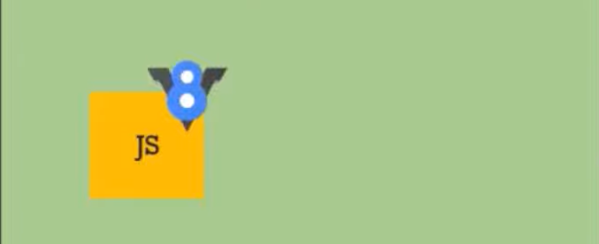
History
In 2009 a programmer named as Ryan Dahl, the creator of node.js he thought it would be great to execute JavaScript outside of the browser and to make this possible he took Google's V8 engine which is the fasted JavaScript engine out there and embedded it inside a C++ program and he called it as node.js
node.js also has certain APIs which provides an environment for the JavaScript code in node.js and these APIs are different from the APIs we have in the browser
So, in short node.js is a program that includes the V8 JavaScript engine and some additional APIs that gives us capability to run JavaScript outside of the browser in a kind of Standalone environment which is node.js
Node JS
C++

Slide 5
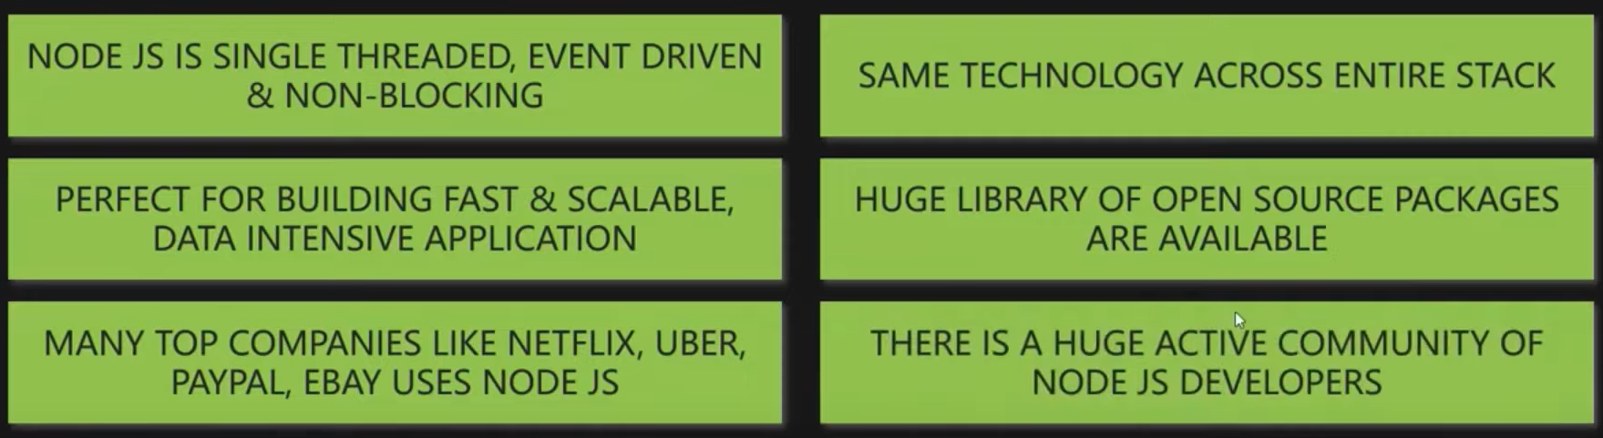
Where should we use node.js and
where not?

Slide 6
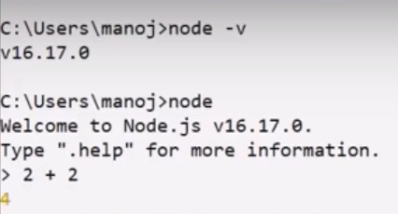
Installation
Node.js — Download Node.js® (nodejs.org)
Node.js has two versions available, LTS and current version.
LTS version is more stable and less frequently updated, making it suitable for enterprise applications.
Current version is frequently updated and potentially contains the latest features and updates.
Once the node.js is installed, now I can execute JavaScript code outside of the browser. For that type node and press enter and this command will start a node environment called REPL (READ, EVAL, PRINT, LOOP) and where we can type some JavaScript code and execute it

Slide 7
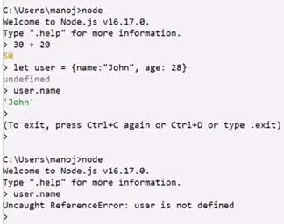
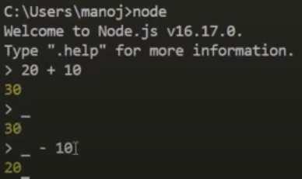
REPL in Node JS
read means reading the user input, eval means evaluating the user input, print means printing or outputting the result and loop means returning and waiting for the new input
once this environment is closed all the variables and objects which we stored earlier are gone
So, the code which we write here is not saved anywhere we can use this environment that is this Rebel to play around with node.js code and execute some JavaScript logic but we don't use it for development purpose
underscore is a spatial variable which stores the result of the previous expression

Slide 8
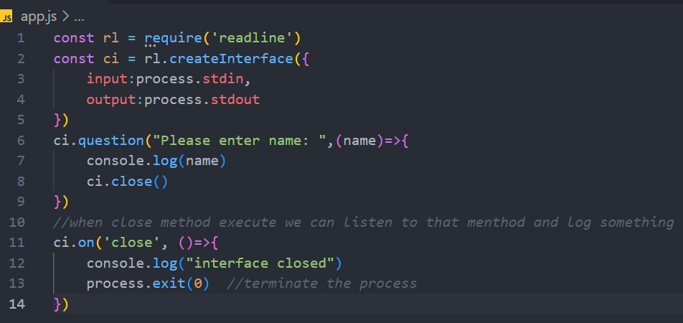
Input and Output

Slide 9
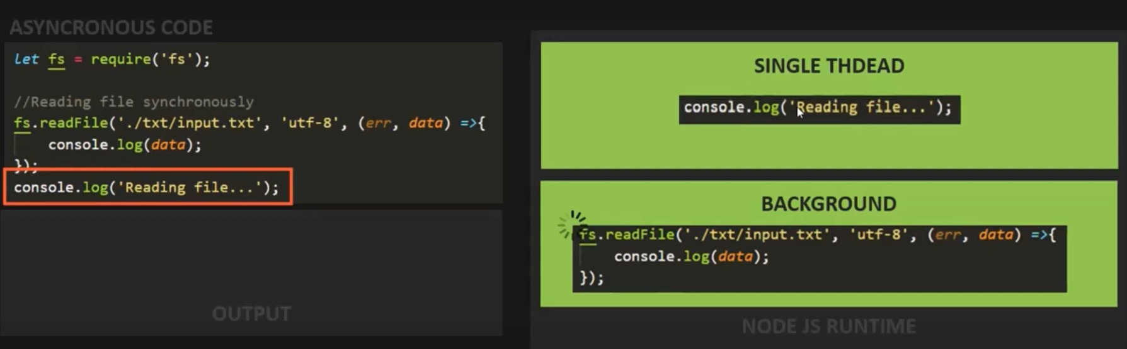
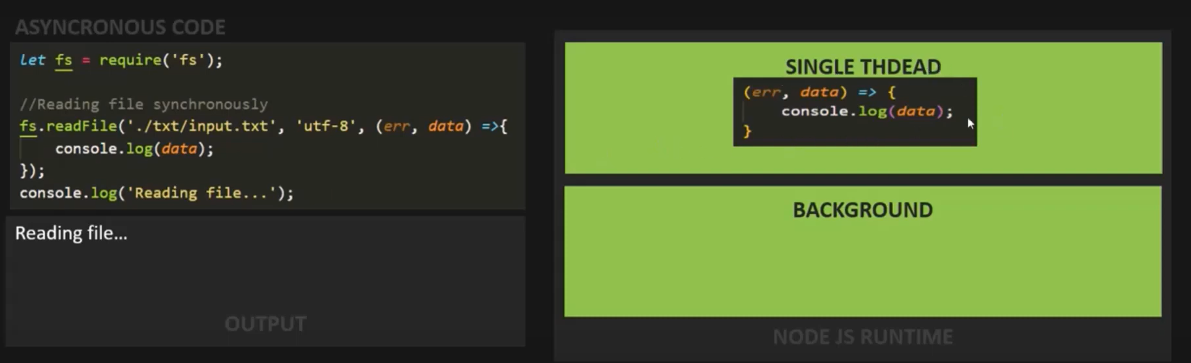
Asynchronous nature of Node JS

Slide 10
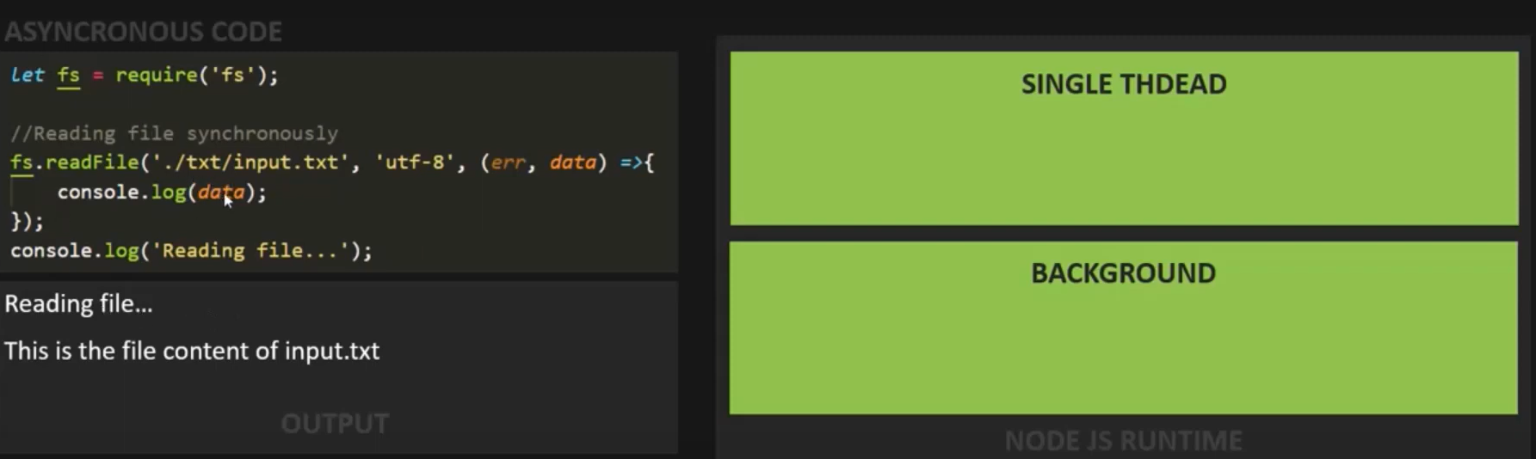
Asynchronous nature of Node JS

Slide 11
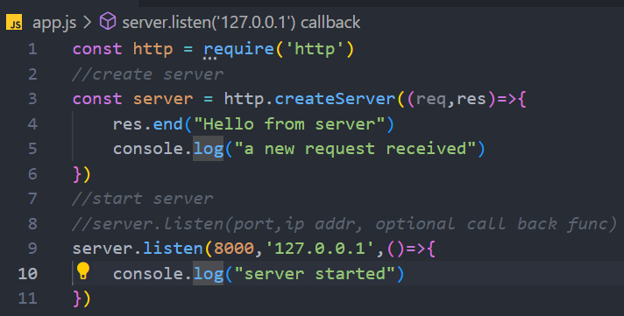
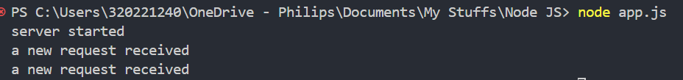
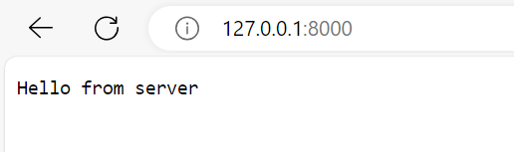
Creating a simple static web server
Start the server by typing node <file.js>
Open different browsers (chrome, edge, etc) and search 127.0.0.1:8000 or localhost:8000

Slide 12
Routing
Routing defines the way in which the client requests are handled by the application in points by implementing routing in our application.
Implementing different actions for different urls
URL patterns
file based urls : mapping the URL with the physical file on the server
localhost:8000/index.html
resource-based urls: mapping a URL pattern to a request Handler by creating the request handler in the backend app using routing.
Localhost:8000/home

Slide 13
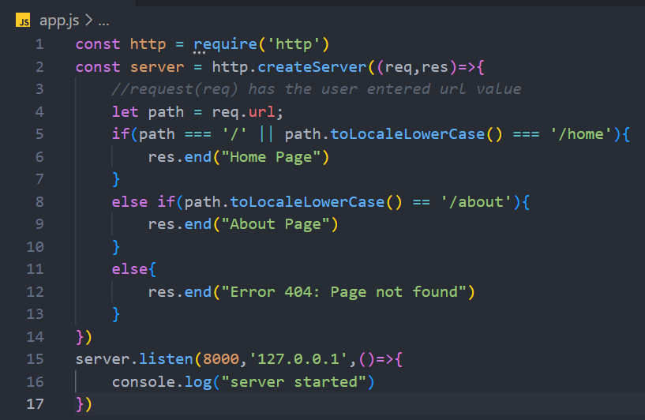
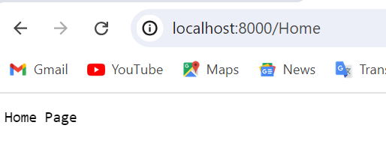
Creating Routes

Slide 14
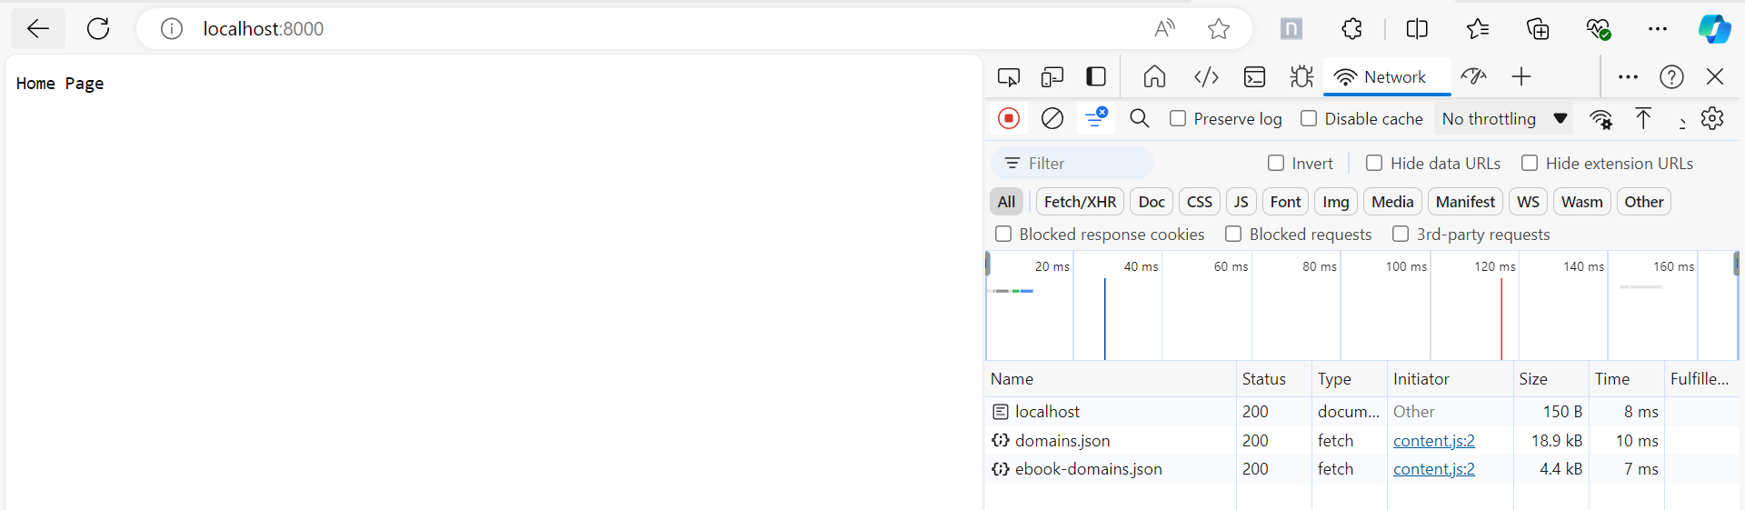
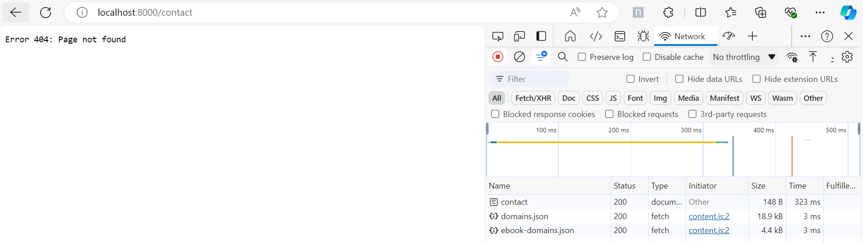
Setting headers for Response

Slide 15
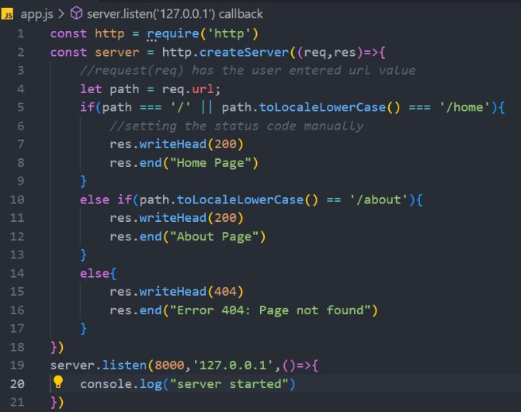
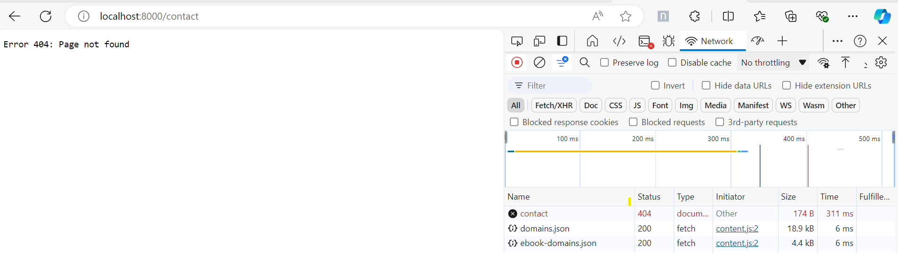
Setting headers for Response

Slide 16
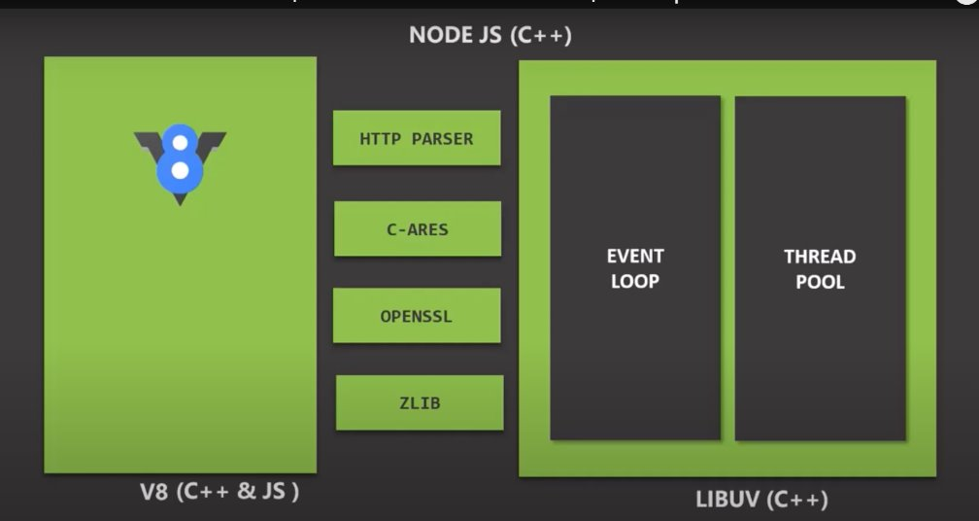
Node JS Architecture
V8 engine is responsible for converting JavaScript code into machine code that a computer can understand and execute.
LIBUV is an open-source library with a strong focus on dealing with asynchronous input output

Slide 17
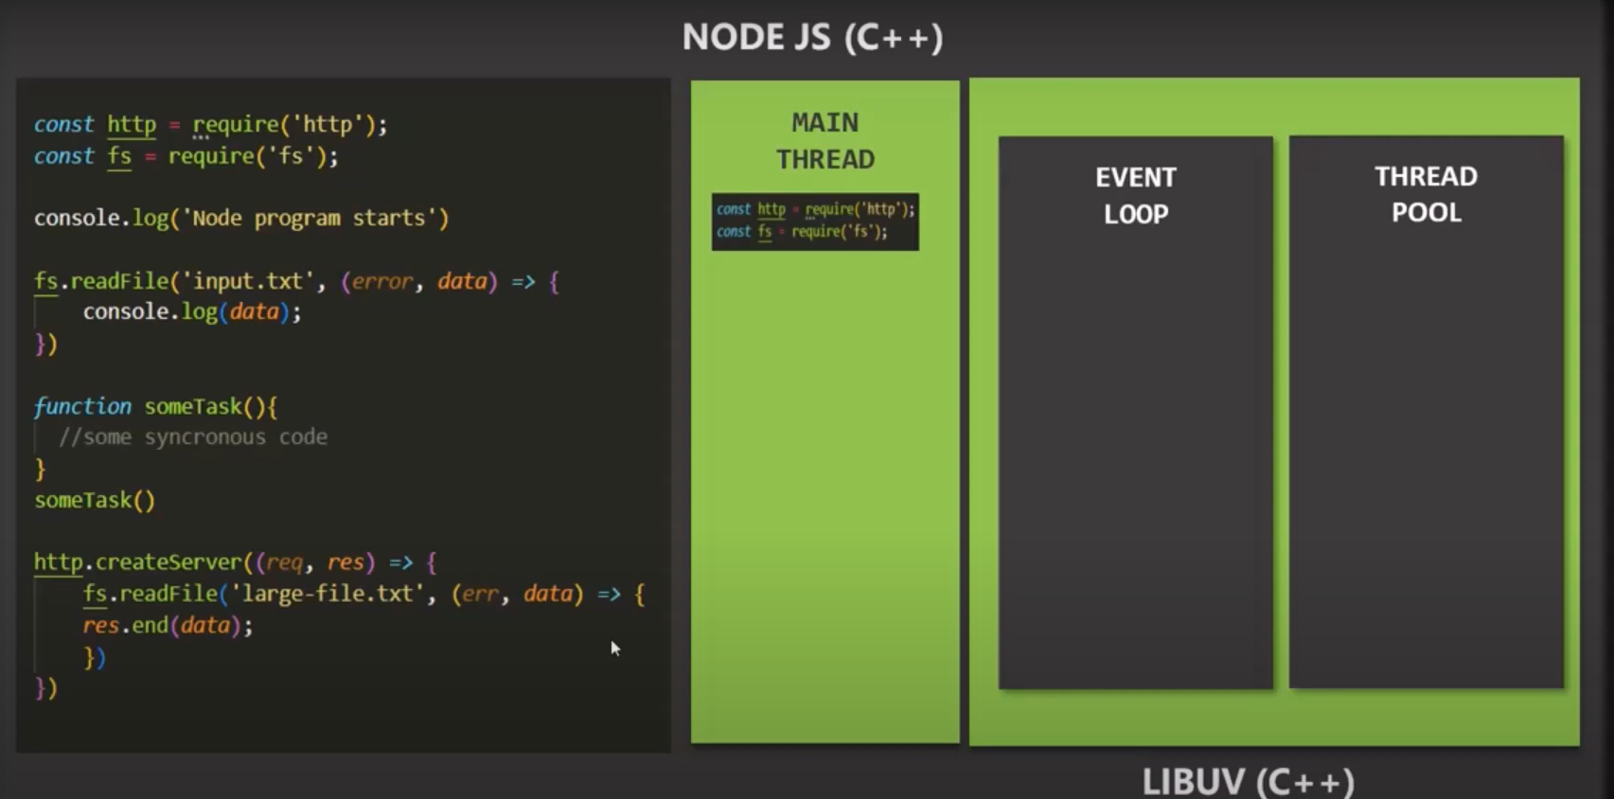
Main Thread
All the top-level codes that means the code which is not inside any callback function will be executed.

Slide 18
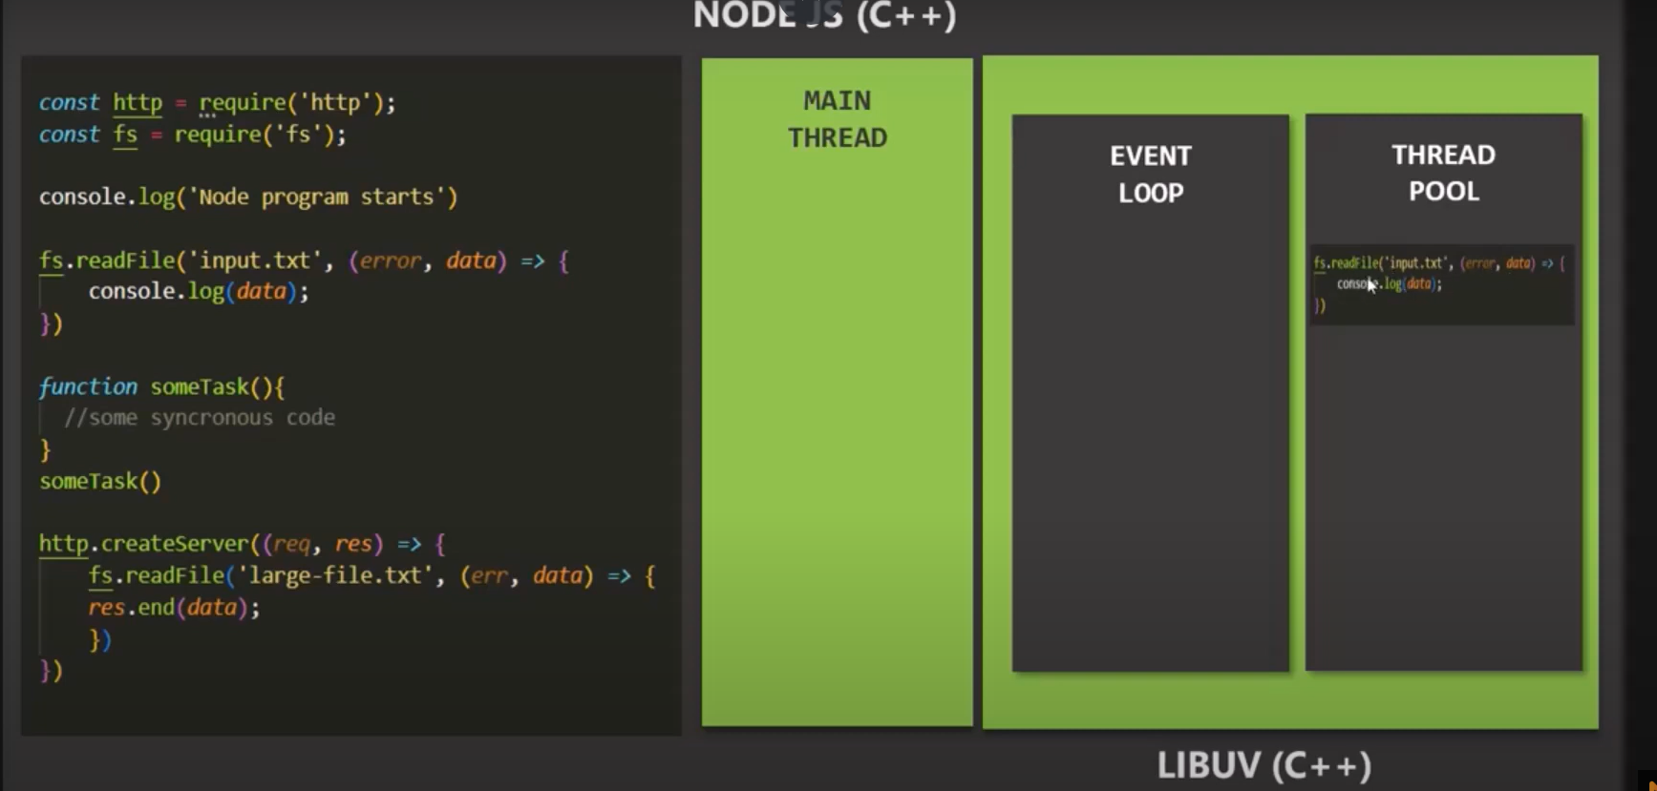
Thread Pool
Functions like this read file which runs asynchronously, or this create server which also runs asynchronously will be executed.

Slide 19
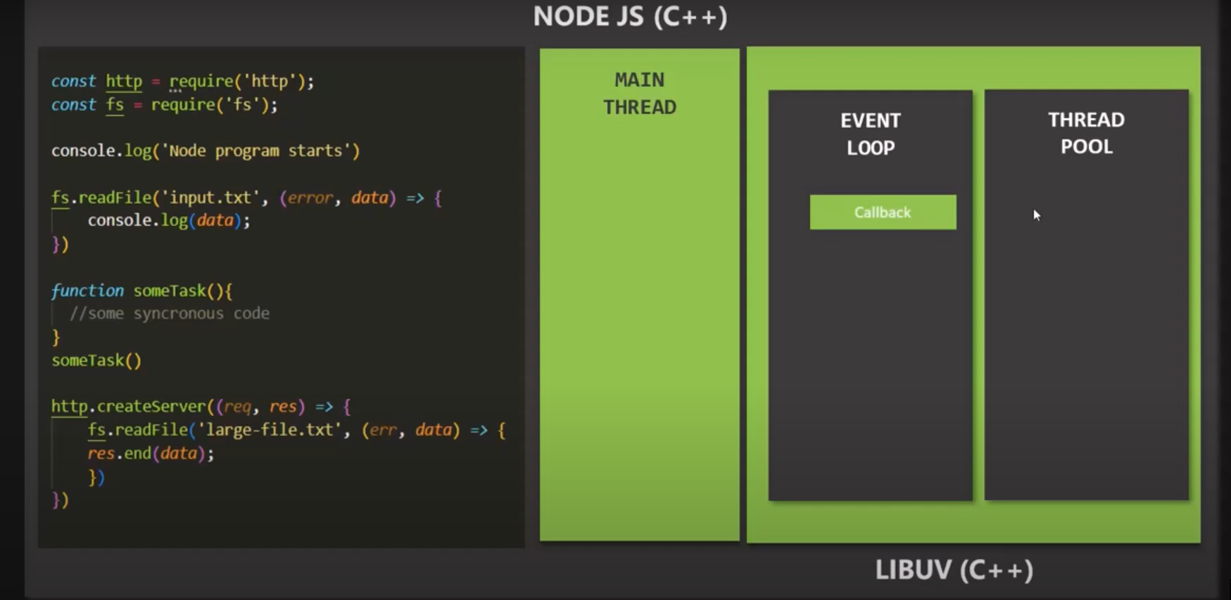
Event Loop
With these asynchronous functions we also have a callback function to read file which will be called when the job of read file function is finished.
once the execution of top-level code is complete the event Loop simply pushes callback functions from callback queue to the main thread where those callback function gets executed

Slide 20
NPM
When working with node.js, we are going to download and install third-party packages from NPM.
NPM stands for node package manager, and it is both a command line interface for managing packages and a package repository (https://www.npmjs.com/) from where we can install and manage packages.
NPM gets automatically installed on the machine when we install node.js.
Example for package repository
https://www.npmjs.com/package/express

Slide 21
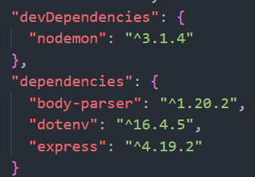
Dependencies
Regular dependency: dependency on which the working of our application depends
Express framework is going to provide us some APIs and classes which we are going to use in our node application
npm install express //regular dependency
Development dependency: dependency which helps us in the development process
npm install nodemon --save-dev //development dependency
To install dev dependency, add –save-dev while installing.

Slide 22
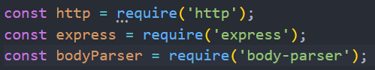
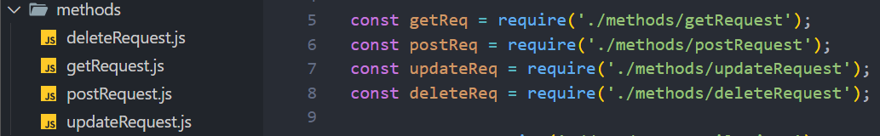
Modules
Module is just another script file from where we can export some values and then those exported values can be used in other script files by simply importing it.
Core Modules: these modules are provided by node.js environment
User defined / Custom Modules: modules which we as a developer creates

Slide 23
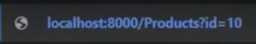
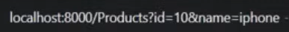
Query String
A query string is basically a key value pair which we specify after a Question Mark (?).
If we want to have two query strings, then we can use the And (&) symbol and then we can specify another query string

Slide 24
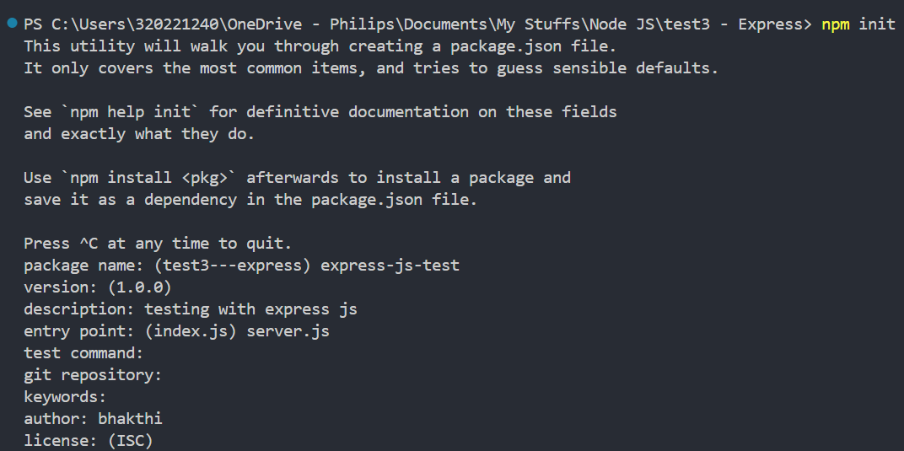
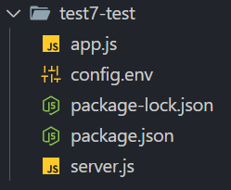
Create package.json file

Slide 25
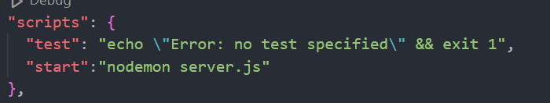
Installing Nodemon & Express
Nodemon is a tool that monitors your source code and restarts your server when it changes. It supports node, python, ruby, make, and other executables, and can be installed with npm.
npm install nodemon –save-dev
npm install express
Add start command in package.json file and use npm start to run the server

Slide 26
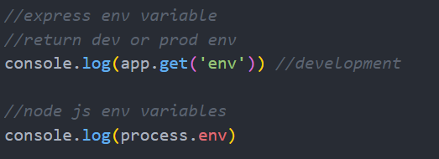
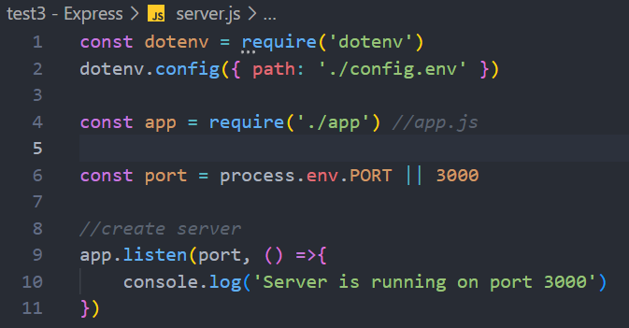
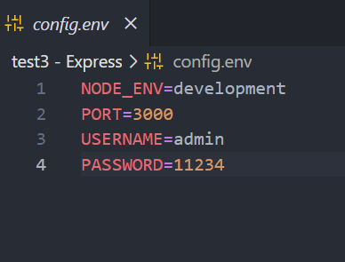
Environment variables
To set the node js env variables there are several ways
Using terminal: SET NODE_ENV=production
Using configuration file - to read the data inside config.env file we need to install a package dotenv - npm install dotenv

Slide 27
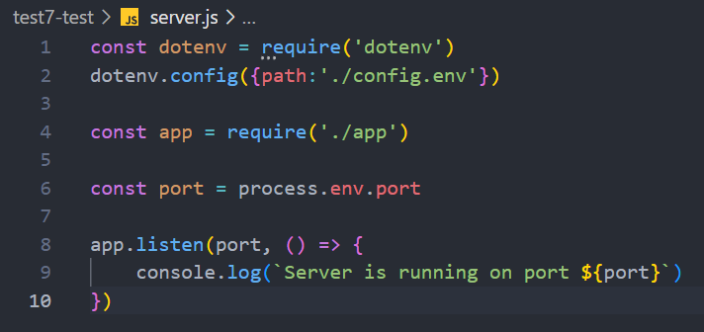
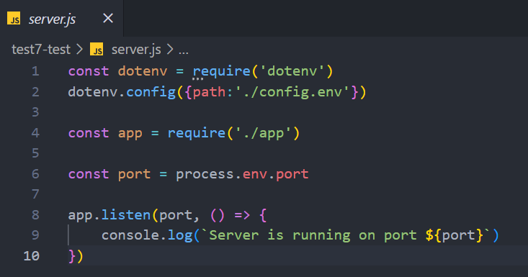
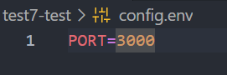

Slide 28
Express.JS
https://www.youtube.com/playlist?list=PL1BztTYDF-QPdTvgsjf8HOwO4ZVl_LhxS
Installing Express (expressjs.com)

Slide 29
Express.js
Express.js is a free and open-source web application framework for node.js Express is a minimal and flexible node.js web application framework that provides a robust set of features for web and mobile application development.
In simple words we can say that Express helps us develop node.js application by writing minimum node.js code it simplifies complex node.js codes with simple one or two line of codes.
So Express is a node.js framework this means that express.js provides some built-in classes and functions which we can use while developing a web application and we can write complex functionalities with simple one or two line of code
https://www.geeksforgeeks.org/node-js-frameworks/

Slide 30
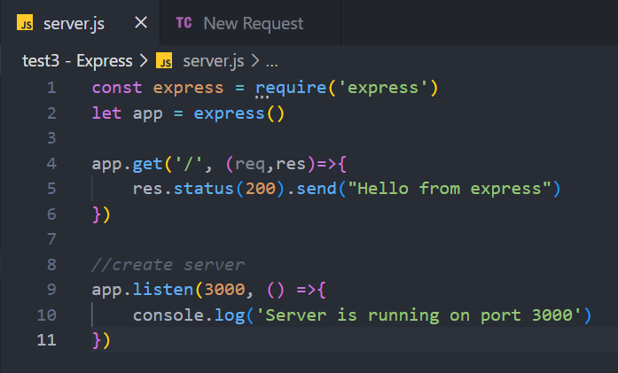
Creating a simple web server using express js

Slide 31
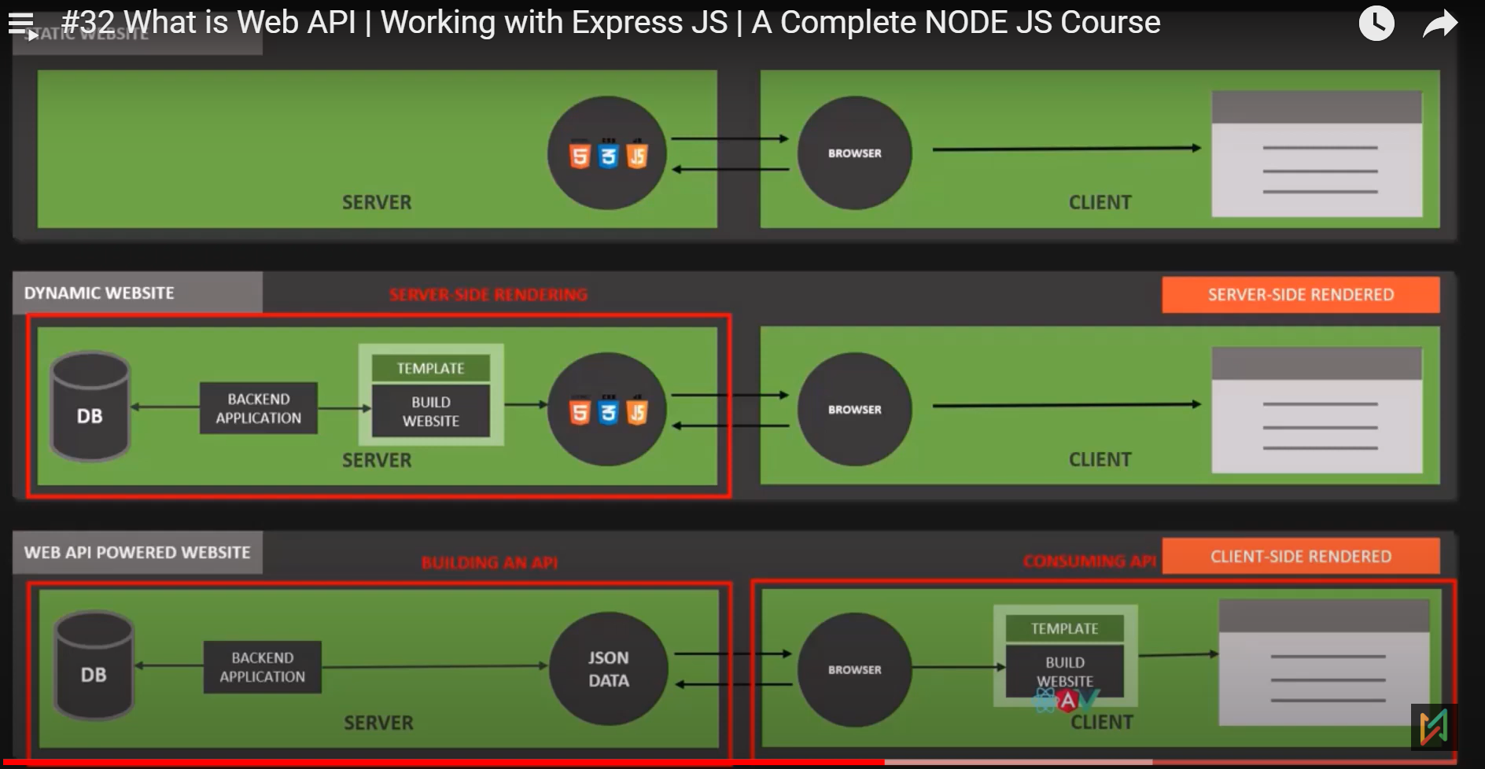
Static, Dynamic, Web API powered websites

Slide 32
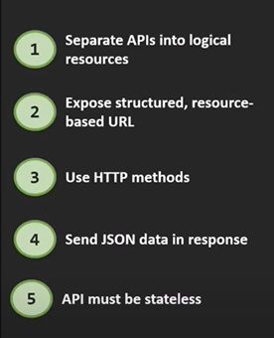
Understanding the REST Architecture
REST stands for representational State transfer, and it is basically a way of building web apis in a logical way making them easy to consume remember that when we build an API it can be consumed by us, or it can also be consumed by others for that we need to make the process of consuming the apis as smooth as possible for the users

Slide 33
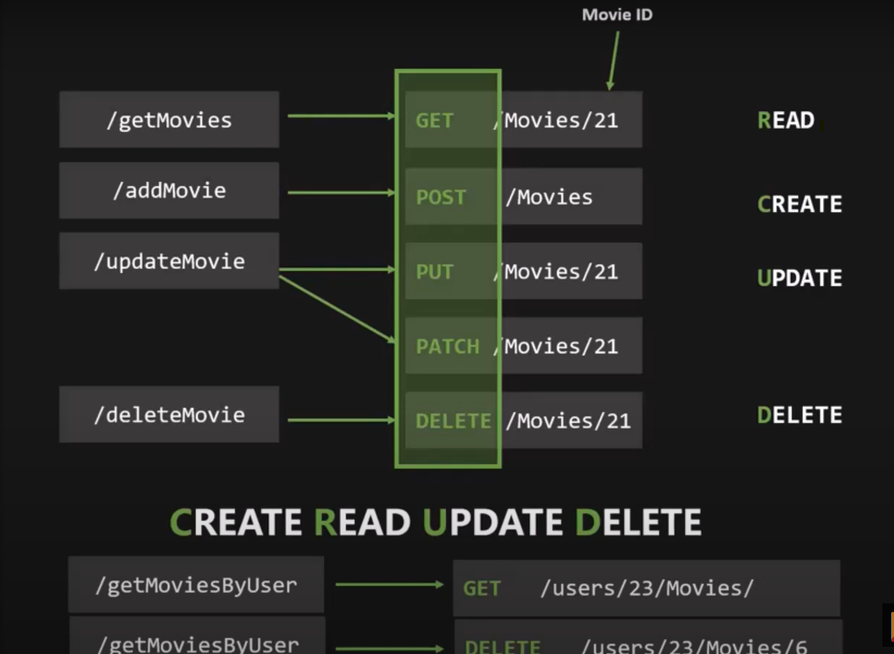
Understanding the REST APIs
Endpoint should contain a noun and not a verb for example get movies update movies delete movies so all these endpoints are verbs so to perform different actions like reading adding updating deleting Etc. the API should use the right HTTP methods and not the end points with verb in it so endpoint should only contain resource and not the action that can be performed​

Slide 34
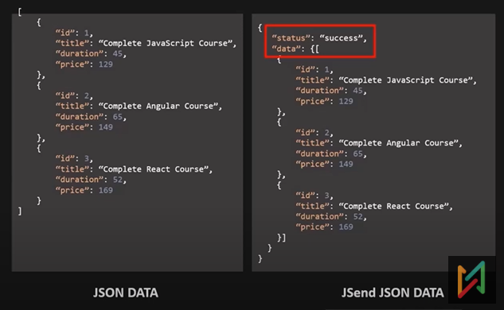
Understanding the REST APIs
we usually do some simple response formatting before sending it to the client and it's a common practice to mitigate some security issues and other problems.
There are a couple of standards for this, and we are going to use a very simple one called Jsend Json data format
Other formats are JSON:API and OData JSON Protocol

Slide 35
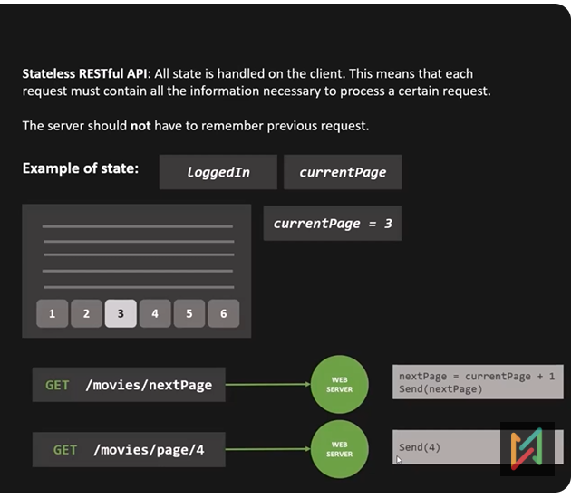


Understanding the REST APIs
In a stateless restful API, all state is handled on the client and not on the server
For example, whether a certain user is logged in or not or what is the current page the user is on out of a list of several pages
server would have to remember the previous request it will have to handle the state on the server side and that is exactly what we want to avoid

Slide 36
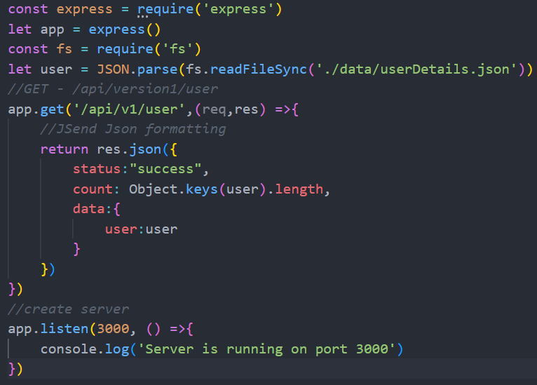
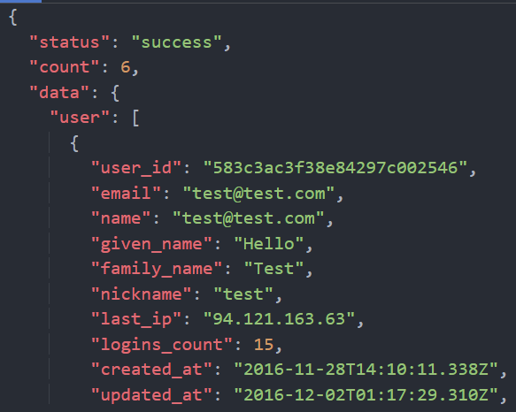
Creating REST APIs - Handling GET request

Slide 37
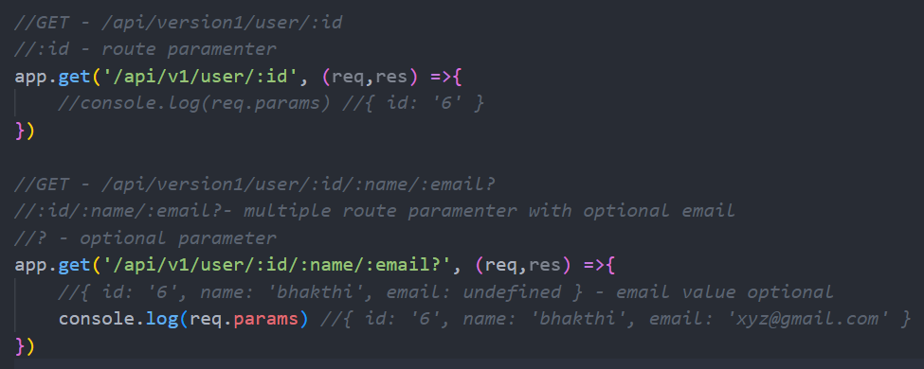
Creating REST APIs - Handling Route Parameters

Slide 38
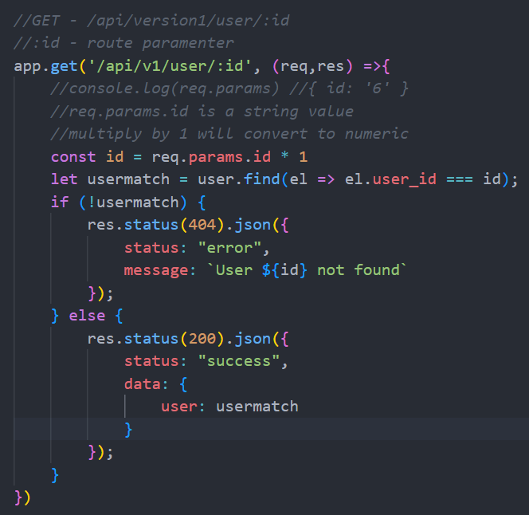
Creating REST APIs - Handling Route Parameters

Slide 39
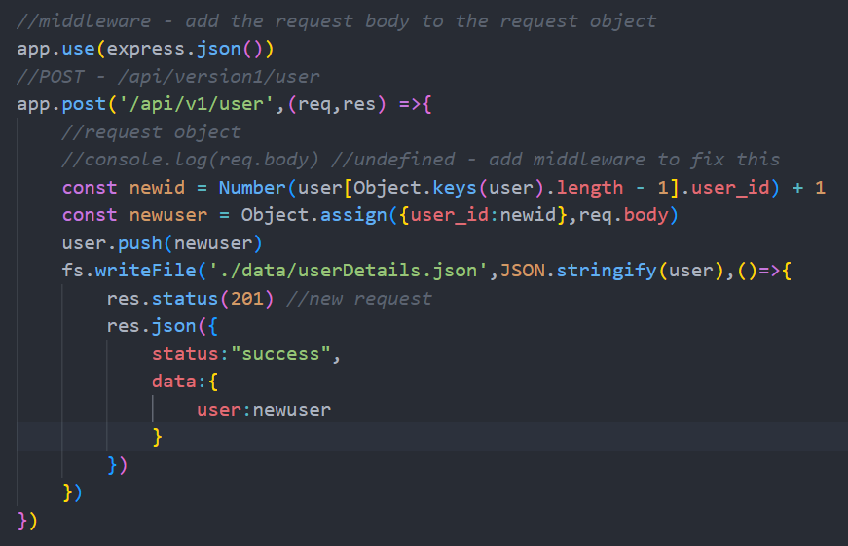
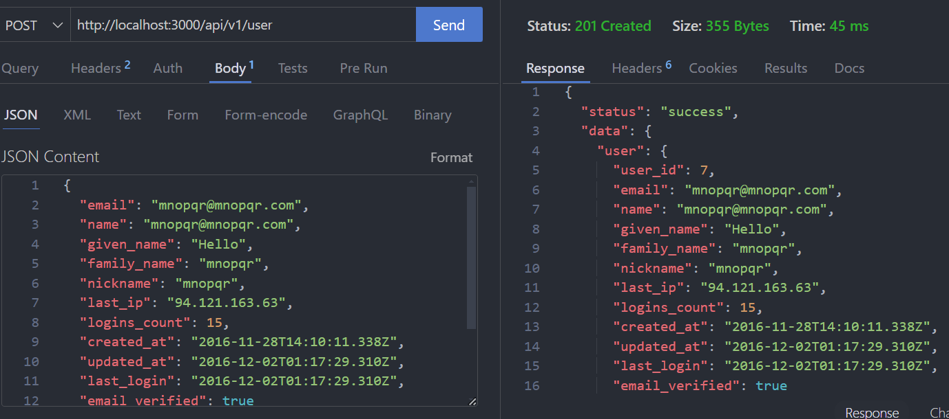
Creating REST APIs - Handling POST request

Slide 40

Diff btw PUT and PATCH http methods

Slide 41

Creating REST APIs - Handling PATCH request

Slide 42

Creating REST APIs - Handling DELETE request

Slide 43


Refactor the code by creating the routes

Slide 44

Understanding the Middleware
Middleware is a function adds the request body to the request objects
Eg: app.use(express.json())
If we have more than one middleware, then we need to call next method for executing the next function
https://expressjs.com/en/resources/middleware.html

Slide 45

Creating a custom middleware

Slide 46


Third party middleware - Morgan
Morgan middleware is particularly useful for debugging and troubleshooting web applications, allowing developers to quickly identify issues and optimize performance. By using Morgan, developers can reduce the size of their log files and make it easier to parse and analyze log data.
It has 2 parameters format and options (optional)
The format argument , a string of a format string, or a function that will produce a log entry.

Slide 47

Mounting Routes in Express
When we use app.use() to use the middleware that middleware is applied on all the requests but there is another overloaded version of this use method which we can use to apply a middleware only to a certain routes.

Slide 48

Understanding param middleware
param middleware is a special middleware which only runs for certain route parameters ( eg: /api/v1/user/:id )

Slide 49



Chaining the middleware
When user makes a post request first validate body middleware will be called after that if the requestbody has valid data then postuser request will be executed

Slide 50

JWT - JSON web tokens
Json web tokens are stateless solution for authentication that means no session state(eg. Credentials of user) is stored on the server and that is perfect for restful apis.
Since the restful API should always be stateless, JWT is used.

Slide 51

JWT - JSON web tokens
All this request and response communication must happen using https protocol basically using a secure and encrypted HTTP request and responses and this is important to prevent anyone from getting access to password or Json web token

Slide 52


JWT - JSON web tokens - https://jwt.io/

Slide 53

JWT - JSON web tokens

Slide 54

JWT with Express
Install package - npm install jsonwebtoken
var jwt = require('jsonwebtoken');
Secret string can be specified in config.env file. It should be atleast 32 characters long. Longer the string safer it is. We can set the expire date for JWT in miliseconds
SECRET_STRING=wqer-eqet12-33@#$%-nh0y82-dd#jyt
LOGIN_EXPIRES=1000000
sign(payload, secret string,optional when JWT should expire)

Slide 55

JWT with Express – signup user

Slide 56

JWT with Express

Slide 57

JWT with Express

Slide 58

Installation
Oracle Database Express Edition (XE) Downloads
Extract the file and click on setup to install oracle db
Install VS Code extension - Oracle SQL Developer Extension for VSCode

Slide 59

Create Connection – oracle db

Slide 60




Slide 61


Slide 62


Slide 63

Monolithic Node JS => Microservice
Consider example: Online Household Product Order App

Slide 64

Monolithic Architecture
Depend on each other

Slide 65

Microservice Architecture

Slide 66

Monolithic NodeJS - Common design pattern

Slide 67


Monolithic - Current design pattern

Slide 68


Monolithic => Microservice

Slide 69
Graphql

